Slide 1
Group Self Learning
Topic : Select menu and progress bar

Slide 2

How to use Jqueryui.com
Before using you must include these links in header

Slide 3
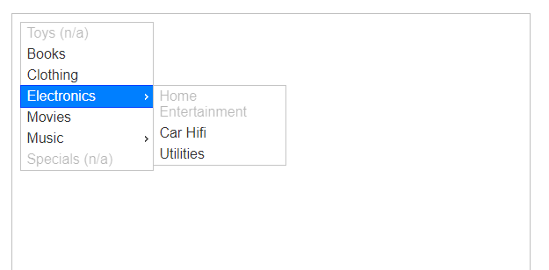
Select Menu
Select menu is an option in Jquery language that allow to hide menu or show menu with using mouse and also can be disable menu also.
We can use nested menu too. Example:

Slide 4
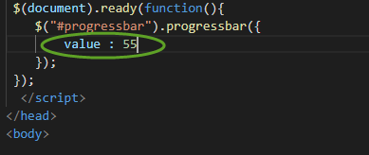
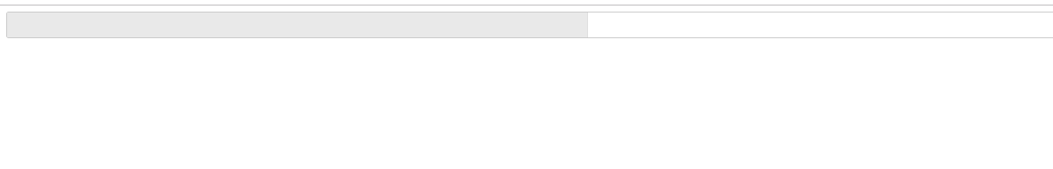
Progress Bar
The progress bar is designed to display the current percent complete for a process
The value can be change.
Example : Coding vs Result

